Slide 1
EE 150
Intermediate Programming Concepts for Engineers
Lecture Notes on
Graphs and Applications

Slide 2
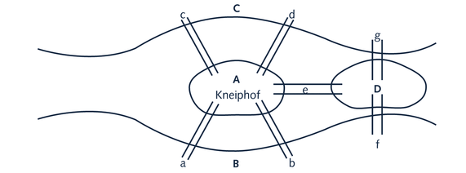
Königsberg Bridge Problem
In 1736, the following problem was posed:
River Pregel (Pregolya) flows around the island Kneiphof
Divides into two
River has four land areas (A, B,C, D)
Bridges are labeled a, b, c, d, e, f, g

Slide 3
Bridges of Koningsberg Problem
The objective was to take a stroll over each of the town’s bridges without crossing one twice
Starting at one land area, is it possible to walk across all the bridges exactly once each and return to your starting area?
Leonard Euler demonstrated that the stroll was only possible if the number of bridges leading to each city district was even

Slide 4
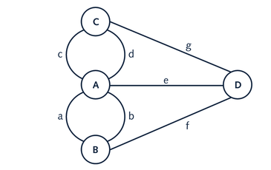
Königsberg Bridge Problem
This marked (as recorded) the birth of graph theory.

Slide 5
Graphs
A graph is a general-purpose data structure that can represent many kinds of programming problems.
A graph G = (V, E) is a data structure which includes the following components :
a set V of vertices (or nodes) which represent the objects being related.
a set E of edges (or arcs) which represent the relationships between the vertices. Each edge may be an ordered or unordered pair of vertices. One or more edges may exist between two given vertices.

Slide 6
Directed Graphs
Each element of E is an ordered pair of vertices (v1, v2), where v1 represents the source of the edge, and v2 represents the destination (or sink) of the edge.
edge e: (v1, v2)
src(e) = v1 and snk(e) = v2
a
b
c
d
"self-loop"
A set of vertices: V = {a, b, c, d}
A set of edges: E = { (a,b), (b,d), (d, c), (c, a), (c, c) }

Slide 7
Undirected Graphs
Each edge is a two-element subset of V. An edge has no direction.
a
b
c
d
A set of vertices: V = {a, b, c, d}
A set of edges: E = { {a,b}, {b,d}, {c, d}, {a, c} }
7

Slide 8
Some Types of Graphs
Graph or Multigraph
Multiple edges between two different vertices (in the same direction) and sometimes self-loops are allowed.
Simple graph
As opposed to a multigraph, a simple graph is an undirected graph that has no loops and no more than one edge between any two different vertices.
Weighted graph
A numerical label is associated with each edge. Edge weights represent information such as distance, connection costs, affinity, resistance, bandwidth, etc.

Slide 9
Graph Applications
Family trees
Nodes are members, with an edge from each parent to each of their children.
Transportation networks
Nodes are airports, intersections, ports, etc.
Edges are airline flights, one-way roads, shipping routes, etc.
Computer networks
Wireless communication networks
Linear system and circuits
A resistor network can be modeled as an undirected graph with each circuit node as a vertex and each resistor as an edge.

Slide 10
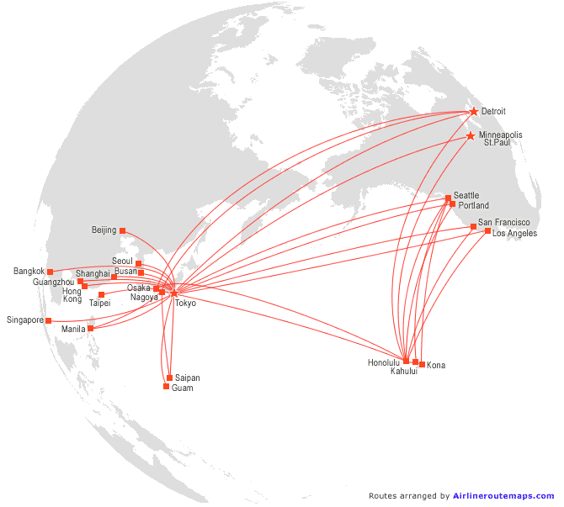
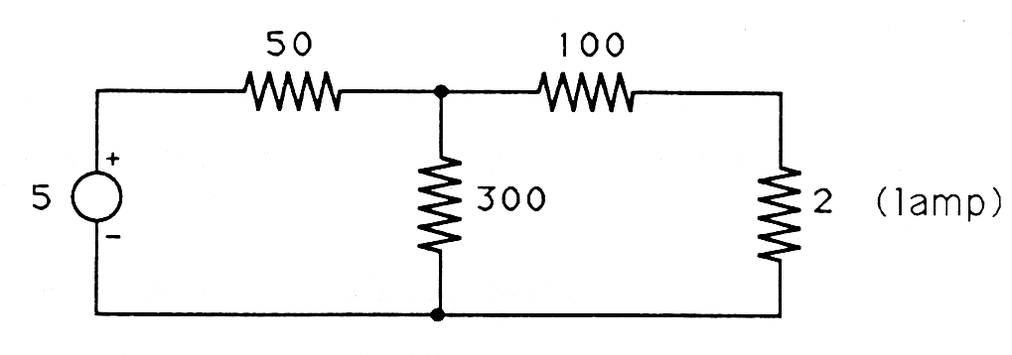
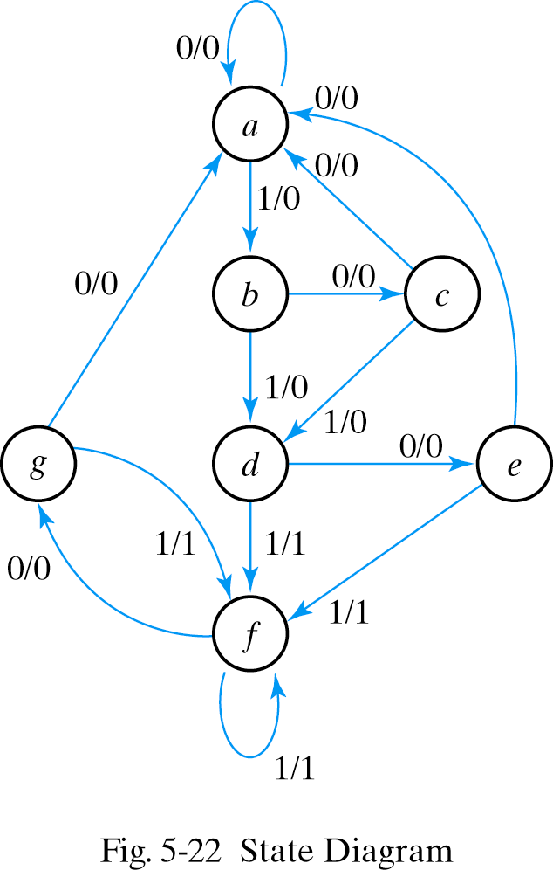
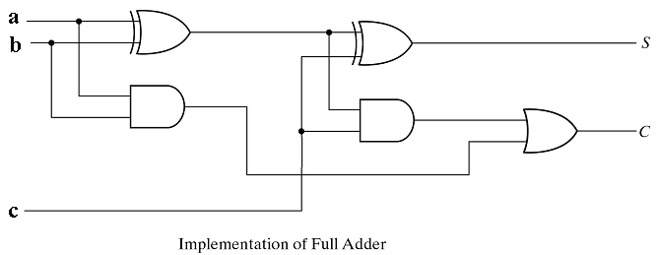
Graph Examples 1

Slide 11
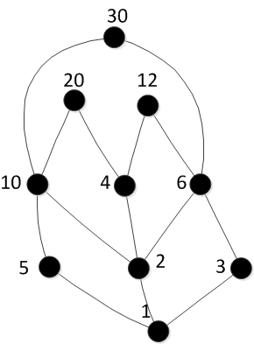
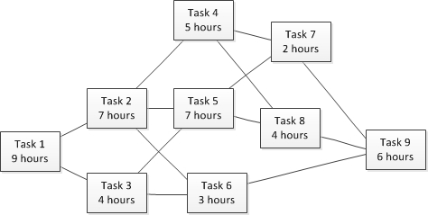
Graph Examples 2
CPM (Critical Path Management) Diagram
Hasse Diagram:
‘divides’ relation

Slide 12
Networks of Resistors
A resistor is a two terminal circuit element that resists the flow of electric charge through it.
Ohm's law states that the voltage v(t) across a resistor and the current i(t) through a resistor are related by
v(t) = R i(t)
where R is the resistance of the resistor in Ohms.
Networks of resistors can be constructed by connecting multiple resistors together.

Slide 13
An Example of a Resistor Network
Node 1
Node 2
R1
R4
R2
Node 4
Node 2
R3
Four resistors are connected together. There are four circuit nodes. A circuit node is a point where two or more electric elements (such as resistors) connect.
Such resistor network can be modeled as an (undirected) graph by creating a vertex for each circuit node, and an edge for each resistor.

Slide 14
Example: Graph Model
N1
R1
N2
R4
R2
N4
R3
N3
A graph model G = (V, E) of the previous resistor network can be specified as follows: V = {N1, N2, N3, N4}, E = {R1, R2, R3, R4} where R1 = {N1, N2}, R2 = {N2, N3}, R3 = {N3, N4}, and R4 = {N1, N4).
Note that this is a simple graph.

Slide 15
Another Example of a Resistor Network
Node 5
N5
R5
R6
R7
R5
R6
R7
Node 6
N6
A graph model G = (V, E) of this resistor network can be specified as follows: V = {N5, N6}, E = {R5, R6, R7} where R5 = {N5, N6}, R6 = {N5, N6}, and R7 = {N5, N6).
Note that this is a multigraph.

Slide 16
Common Data Structures for Graphs
How to store graphs in a computer?
Two methods we’ll discuss:
Adjacency Matrix
Adjacency List

Slide 17
Graph Representation 1
Adjacency Matrix
The adjacency matrix shows which nodes are adjacent to one another. Two nodes are adjacent if there is an edge connecting them.
For a graph with n vertices, an adjacency matrix is a two-dimensional n × n Boolean matrix A, where each element a_{ij} = 1 if there is an edge between the vertices i and j; and 0 otherwise.
More sophisticated adjacency matrix representations are possible where the values are replaced by either information or pointers to information associated with the corresponding edge (such as resistances, distances, costs).

Slide 18
Graph Representation 2
Adjacency List
An adjacency list is implemented as an array of linked lists, with one list of destination nodes for each source node.
Information associated with an edge (edge weighting, for example) can be maintained in the list entry.

Slide 19
Adjacency Matrix (Undirected)
A = (a )
1
ij
1 if (i, j) ∈ E(G)
0
2
a =
ij
0 otherwise
0 1 2 3 4
4
3
0 0 1 1 0 1
1 1 0 1 0 0
2 1 1 0 1 1
3 0 0 1 0 1
4 1 0 1 1 0

Slide 20
Adjacency Matrix (Directed)
1
A = (a )
ij
1 if (i, j) ∈ E(G)
0
2
a =
ij
0 otherwise
4
3
0 1 2 3 4
0 0 0 0 0 1
1 1 0 1 0 0
2 1 0 0 0 0
3 0 0 1 0 0
4 0 0 1 1 0
20

Slide 21
Adjacency Lists (Undirected)
Adj
1
0
1
2
4
1
0
2
0
2
2
0
1
3
4
3
2
4
4
3
4
0
2
3
21
21

Slide 22
Adjacency Lists (Directed)
Adj
1
0
4
1
0
2
0
2
2
0
3
2
4
3
4
2
3
22
22
22

